Slide 1
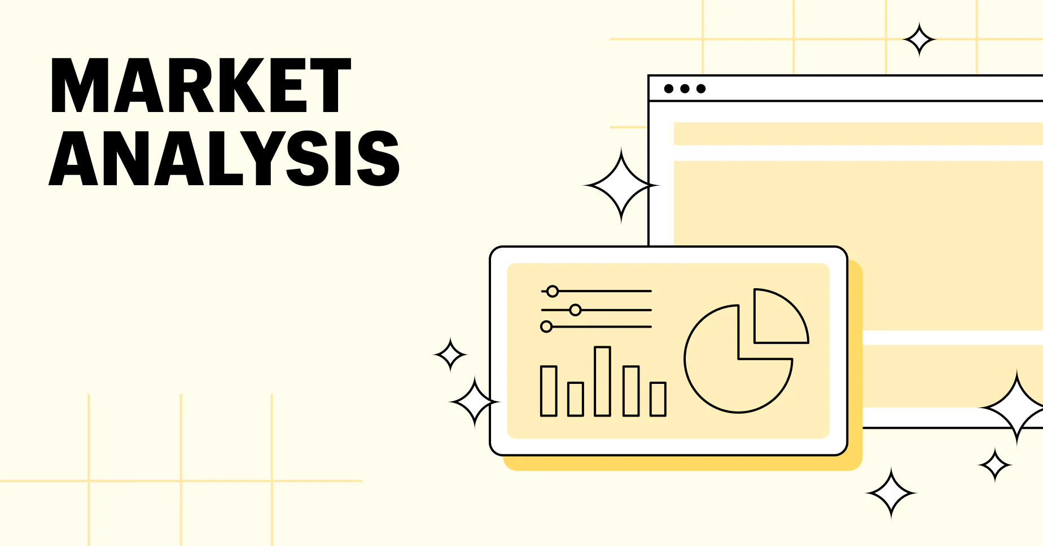

Slide 2

Dataset of Market Analysis
City_Master
Customer_and_bank_details_p1
Customer_campaign_details_p1
Customer_Postal_Code_details
Customer_Response_data_p1
Customer_social_economic_data_p1
Region_code_master
State_Master

Slide 3
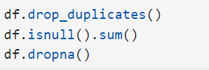
Clean up the Data
Remove duplicate data
Ensure consistency
Finding null values and unknown values.
Update missing data

Slide 4
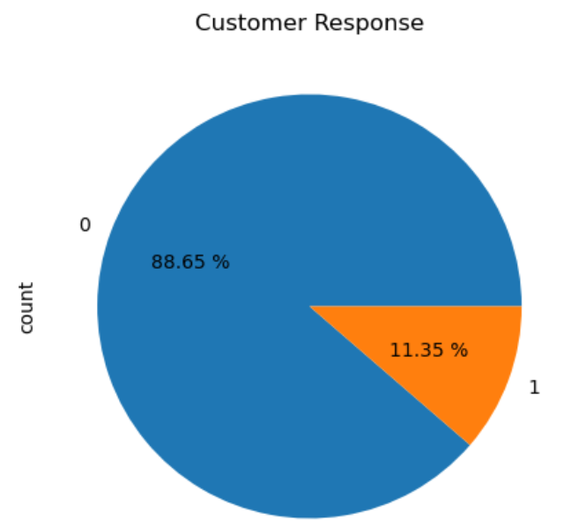
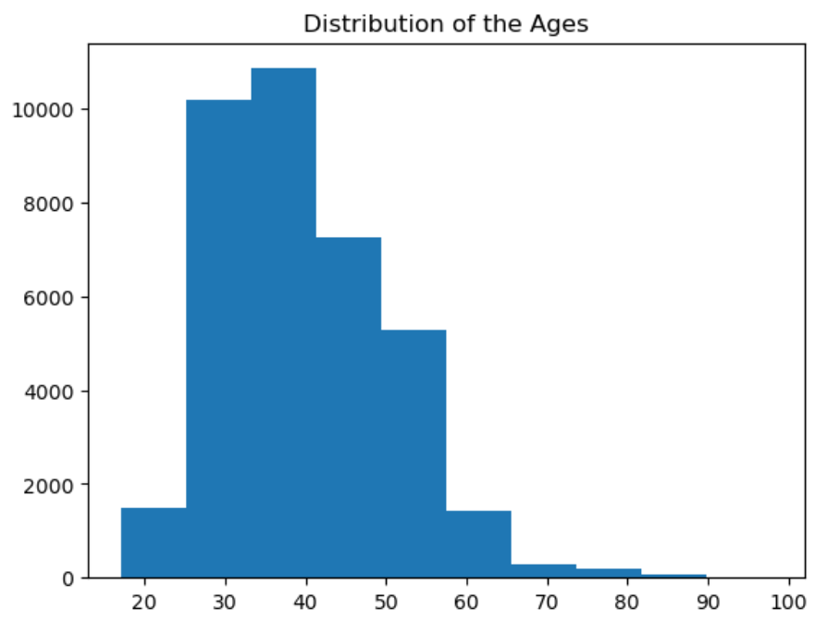
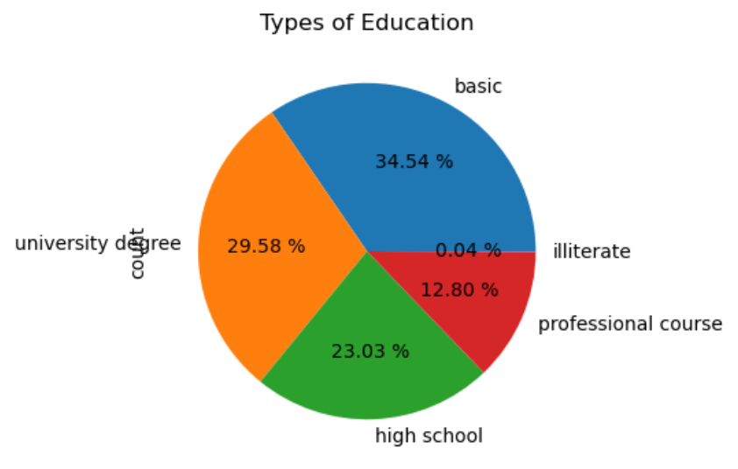
Data Visualization
Visualize the data using matplotlib, seaborn libraries.
Compare customers based on the different attributes.

Slide 5

Relational Schema
Relational Schema represents name of the relation with its attributes.
E.g: Customer ( id, age, gender, state) is relational schema for CUSTOMER.
ER Diagram represents the conceptual level of DB design, while relational schema is logical level for database design.
Entities and Attributes
Primary keys
Foreign keys

Slide 6
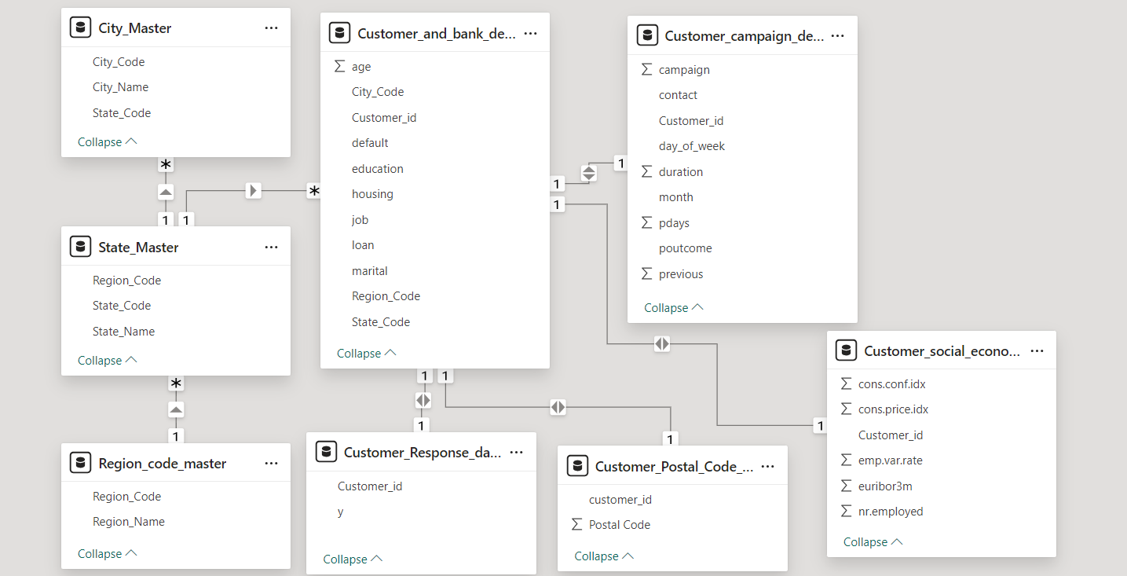
ER diagram

Slide 7

SQL
Generate the list of customer who has credit and has been contacted more than 2 times during the campaign.
Generate the list of customer who has credit and has been contacted more than 2 times during the campaign and outcome of the campaign is successful.
Generate the list of customer who has credit and has been contacted more than 2 times during the campaign and outcome of the campaign is failure and who have been contacted in the month of June and also display the day contacted.
Generate report giving state-wise breakup of number of customers
Generate report giving city-wise distribution of customers

Slide 8
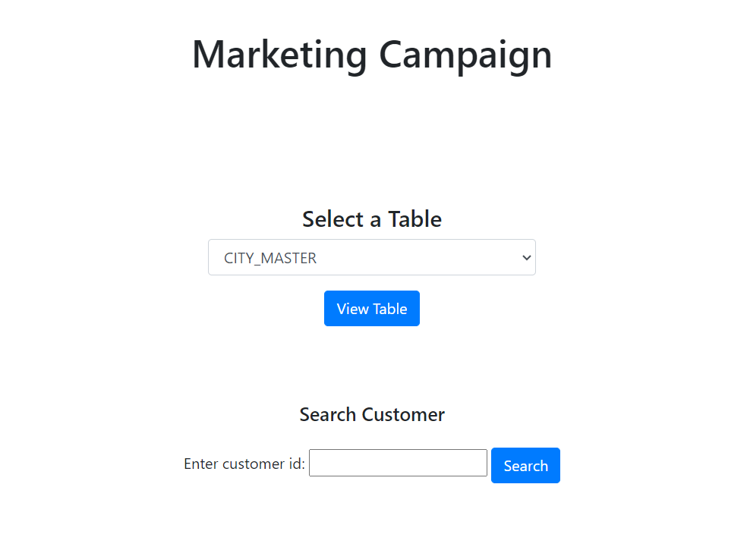
Flask Application
Search details of the customer
Get the information about tables
View and delete each row.

Slide 9
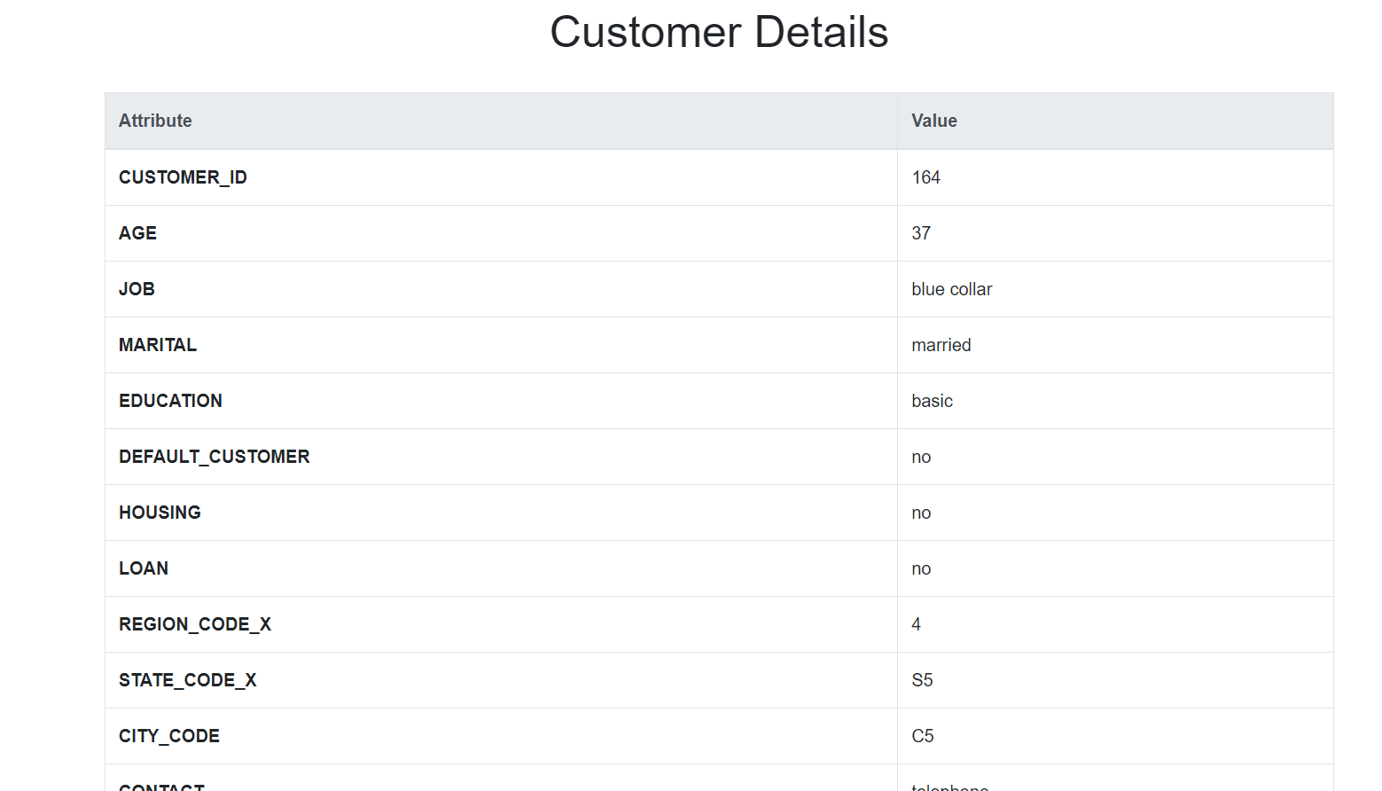
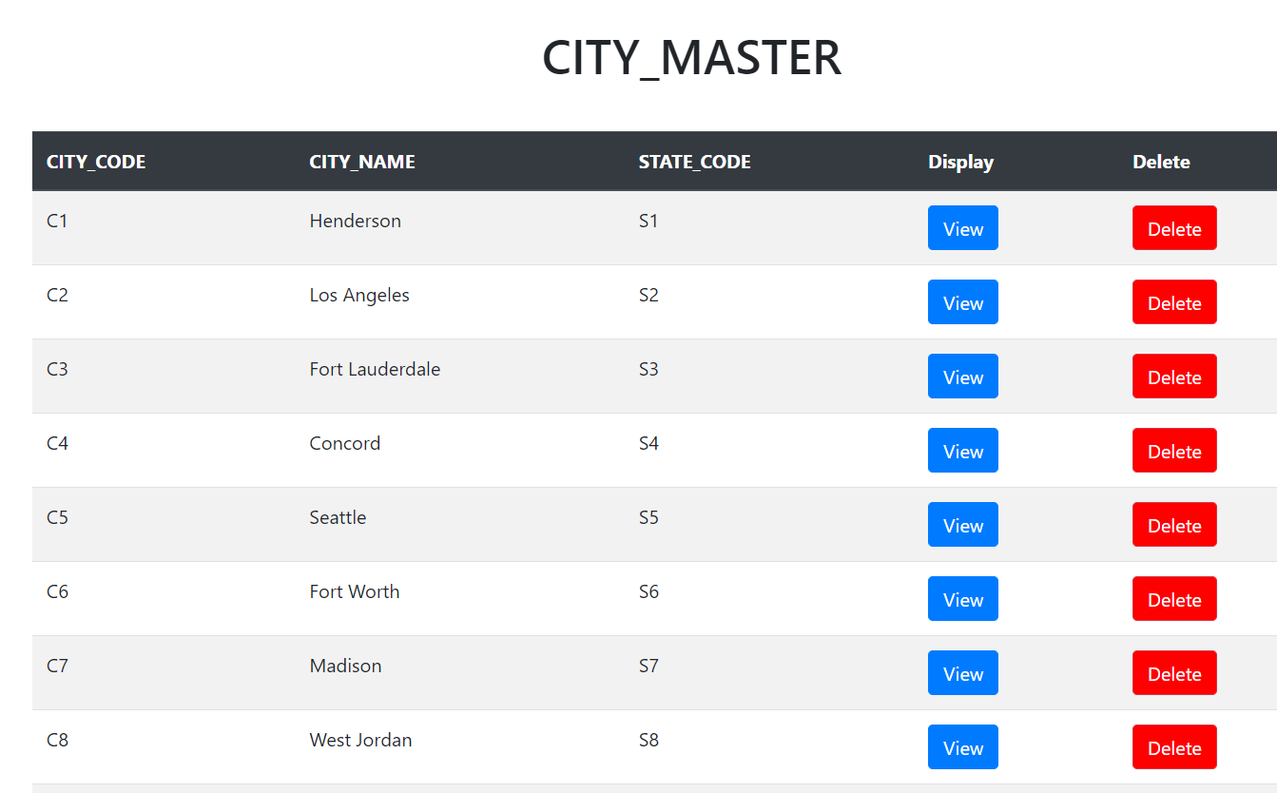
Customer Details
Table details

Slide 10
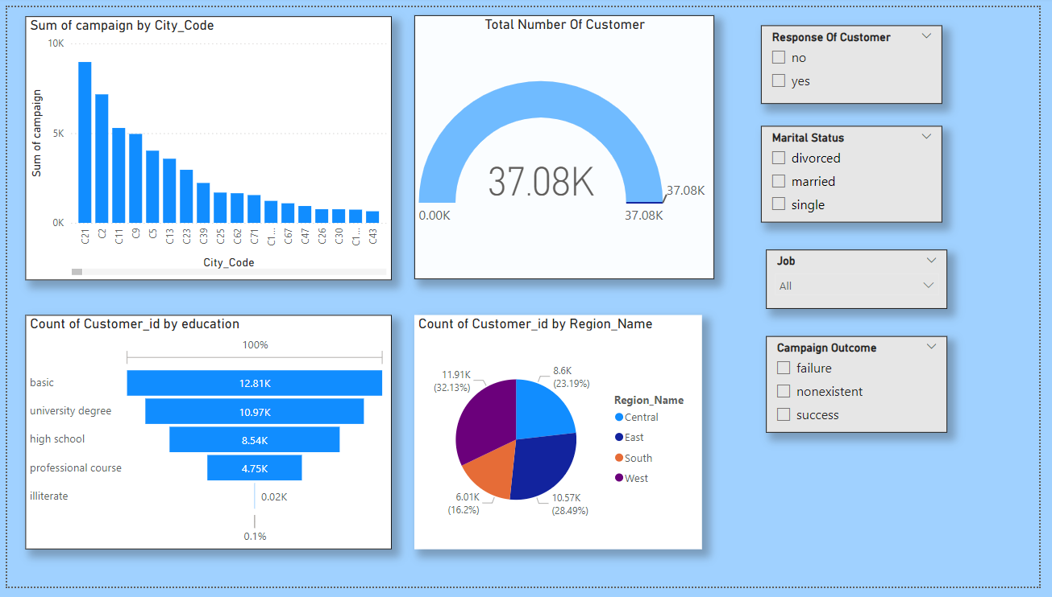
Power Bi Dashboard

Slide 11
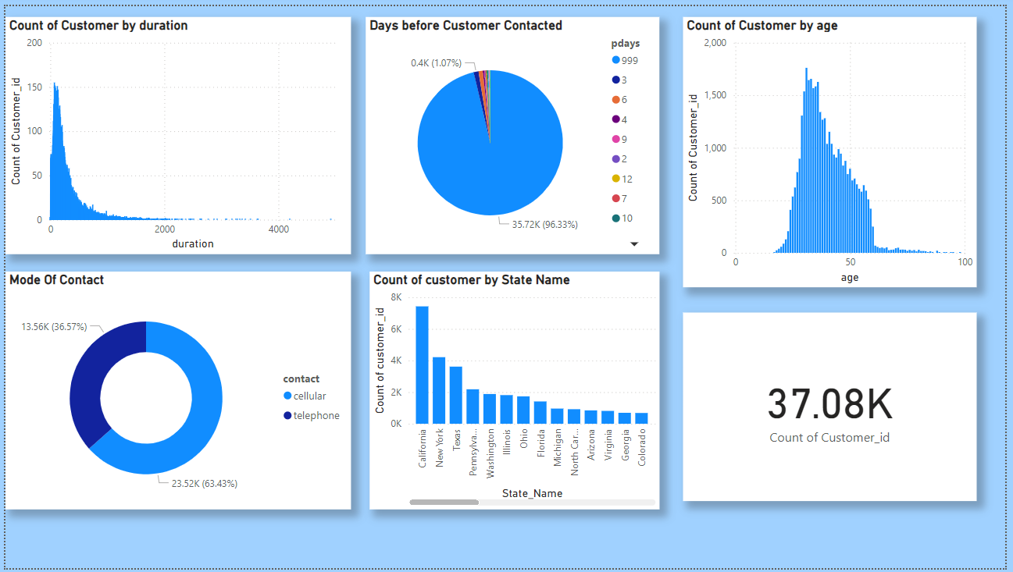

Slide 12
AWS
At last we use AWS to deploy our flask application and run it using AWS service.
For this we use AWS Cloud9 service to run our flask application.
Cloud9 is a cloud-based integrated development environment (IDE) that lets you write, run, and debug your code with just a browser.

Slide 13
